Slide 1

St. Augustine’s Primary
Meet the Teacher Meeting
Year 1
September 2023

Slide 2

The Teaching Team
Class teacher: Miss Olivia Ludolf
Classroom support:
TA - Mrs Heroida Mahmutaj (Monday – Thursday)
LSA – Ms Rashida
Extra Support (afternoon only):
Ms Major (Monday and Thursday)
Ms Monica (Monday)
Ms Roda (Wednesday)

Slide 3

Support
Phase Leader: Mrs Toussaint (Year 3 teacher)
Inclusion/SEND: Catrin Cunnington

Slide 4
The school day
8:45am | Gates open – Soft Start
9:00am | Morning register
9:10am | Collective worship
10:45am | Morning break
12:00noon | Lunch break
1:00pm | Afternoon register
3:30pm | School day ends
3:45pm | After-school clubs start
4:45pm | After-school clubs end

Slide 5

Routines
Soft start - 8:45 – handwriting, recap learning, phonics interventions
Lunch - 12:00 – 12:55
End of the day - 3.30pm - children must tell an adult before leaving the school.

Slide 6
Expectations
Attendance
Punctuality
School and class rules
Responsibilities
Rewards
Sanctions
Healthy school – packed lunches and nut free/ kiwi free policy

Slide 7
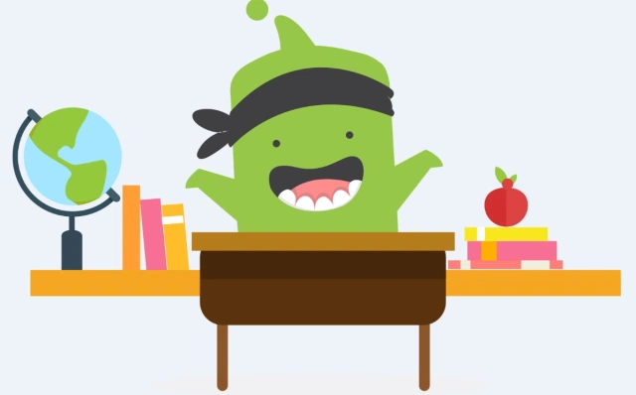
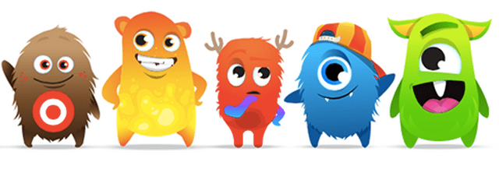
Expectations
Class Dojos
Children are awarded Class Dojos in class for showing our school values
Wonderful Work and Shining Stars
A certificate is given out weekly by the Headteacher to celebrate an individual's contribution

Slide 8
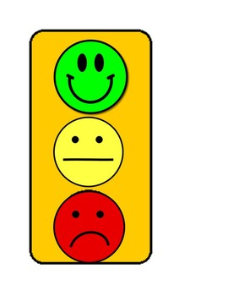
Expectations
Traffic Light System
A class traffic light system is in place in classrooms for when children are not following the rules. All children start on green at the beginning of each day
Moving to red will result in a 5-minute think time in class
If the child continues to not follow the rules then it will result in a 15-minute think time, which parents will be informed of
If the child receives 3 think sheets within a term, parents will be called for a meeting to discuss next steps to support you child

Slide 9
School Values
Friendship
Respect
Wisdom
Inclusion
Honesty
Courage
“To be the best that we can be in faith, hope and love so that we may live life in all its fullness.”

Slide 11

Year 1 Geography Curriculum
Geography Long Term Plan | Autumn 1 | Autumn 2 | Spring 1 | Spring 2 | Summer 1 | Summer 2
Year 1 | What is it like here? Locating where they live on an aerial photograph, children recognise local features. They create maps using classroom objects before drawing simple maps of the school grounds. Pupils use maps to follow simple routes around the school grounds and carry out an enquiry about how to improve their playground. To locate the school on an aerial photograph To create a map of the classroom To locate key features of the playground To draw a simple map To investigate how we feel about our playground To create a design to improve our playground |  | What is the weather like in the UK? Studying the countries and cities that make up the UK, children discuss the four seasons and their associated weather. They consider how we change our behaviour in response to different weather and keep a weather diary or record. Finally, children investigate the UK’s hot and cold places using weather maps with a simple key. To locate the four countries of the UK To identify seasonal changes in the UK To identify the four compass directions To investigate daily weather patterns To identify daily weather patterns in the UK To understand how the weather changes with each season |  | What is it like to live in Shanghai? Using a world map, children start recognising continents, oceans and countries outside the UK with a focus on China. They identify physical features of Shanghai using aerial photographs and maps before identifying human features, through exploring land-use. Pupils then compare these features to those in the local area and make a simple map using data they have collected through fieldwork. To recognise physical and human features To draw a sketch map To name and locate some continents on a world map To identify physical and human features of a non-European country To describe what it is like in Shanghai To compare Shanghai to a small area of the UK

Slide 12
Year 1 History Curriculum
History Long Term Plan | Autumn 1 | Autumn 2 | Spring 1 | Spring 2 | Summer 1 | Summer 2
Year 1 |  | Celebrations What do we celebrate throughout the year? Pupils will learn about celebrations that happen due to something occurring in the past. They will sequence significant events that have occurred during their time in Reception and will look at the historical significance of the Gunpowder Plot. To sequence celebrations that occur throughout the school year To recognise how life was different when Guy Fawkes was alive To identify reasons why the Gunpowder Plot occurred To sequence the events of the Gunpowder Plot To act out the events of the Gunpowder Plot, including the fate of the plotters To understand how and why the Gunpowder Plot is remembered |  | Toys How have toys changed? Pupils compare how toys in the past have changed by looking at the Victorian period and the introduction of electricity. To find out about toys in living memory To find out about toys in the Victorian period To find out about the introduction of plastic To find out about how toy cars have changed over time To place toys in chronological order To recognise some ways in which toys have changed over time |  | Transport How has transport changed? Pupils will gain an understanding of how transport has changed over time with a focus on the railway system. They will investigate the creation of local rail stations and the underground tube system. To know about transport in the Victorian period To recognise similarities and differences between the past and the present To know about the introduction of trains To know the significant event of the introduction of the tube system Transport Museum Class Trip To sequence events related to the introduction of the tube station

Slide 13
Year 1 Art and Design Curriculum
Art and Design Long Term Plan | Autumn 1 | Autumn 2 | Spring 1 | Spring 2 | Summer 1 | Summer 2 | Additional Lessons
Year 1 | Drawing: Make your mark (5 lessons) Developing observational drawing skills when exploring mark-making. Children use a range of tools, investigating how texture can be created in drawings. They apply their skills to a collaborative piece using music as a stimulus and investigate artists Bridget Riley and Zaria Forman. To know how to create different types of lines To explore line and mark-making to draw water To draw with different media To develop an understanding of mark making To apply an understanding of drawing materials and mark-making to draw from observation |  | Painting and mixed media: Colour splash (5 lessons) Exploring colour mixing through paint play, children use a range of tools and work on different surfaces. They create paintings inspired by Clarice Cliff and Jasper Johns. To investigate how to mix secondary colours To apply knowledge of colour mixing when painting To explore colour when painting To experiment with paint mixing to make a range of secondary colours To apply their painting skills when working in the style of an artist |  | Sculpture and 3D: Paper play (5 lessons) Creating simple three-dimensional shapes and structures using familiar materials, children develop skills in manipulating paper and card. They fold, roll and scrunch materials to make their own sculpture. There are opportunities to extend learning to make a collaborative sculptural piece based on the art of Louise Bourgeois. To roll paper to make 3D structures To shape paper to make a 3D drawing To apply paper-shaping skills to make an imaginative sculpture To work collaboratively to plan and create a sculpture To apply painting skills when working in 3D |  | Craft: Woven wonders (Lesson 1, 2 and/or 3)

Slide 14
Year 1 Design and Technology Curriculum
Design and Technology Long Term Plan | Autumn 1 | Autumn 2 | Spring 1 | Spring 2 | Summer 1 | Summer 2 | Additional Lessons
Year 1 |  | Structures: Constructing a windmill (4 lessons) Designing, decorating and building a windmill for their mouse client to live in, developing an understanding of different types of wind mill, how they work and their key features. To include individual preferences and requirements in my design To make a stable structure To assembly the components of my structure To evaluate my project and adapt my design |  | Textiles: Puppets (4 lessons) Exploring different ways of joining fabrics before creating their own hand puppets based upon characters from a well-known fairy tale. Children work to develop their technical skills of cutting, gluing, stapling and pinning. To join fabrics together using different methods To use a template to create my design To join two fabrics together accurately To embellish my design using joining methods |  | Cooking and Nutrition: Fruit and vegetables (4 lessons) Handling and exploring fruits and vegetables and learning how to identify which category they fall into, before undertaking taste testing to establish their chosen ingredients for the smoothie they will make a design packaging for. To identify if a food is a fruit or a vegetable To identify where plants grow and which parts we eat To taste and compare fruit and vegetables To make a fruit and vegetable smoothie | Mechanisms: Making a moving story book (Lesson 1)

Slide 15

Key Objectives
Maths
Shape and patterns
Numbers to 100 and beyond
Addition and subtraction
Telling the time
Fractions
Measurements; lengths, mass, capacity and volume
Money
Multiplication and division

Slide 16
Key Objectives
Writing
Write with capital letters, full stops, question marks and exclamation marks to demarcate sentences.
Sequencing sentences to form short narratives.
Re-reading what they have written to check that it makes sense.
Spell words containing each of the 40+ phonemes already taught (phonetically plausible).

Slide 17
Key Objectives
Phonics
At St. Augustine’s we use the ‘Letters and Sounds – Little Wandle’ scheme of work to teach the children how to read and write.
Read accurately by blending sounds in unfamiliar words containing Grapheme-Phoneme Correspondences (GPCs) that have been taught.
Read tricky words, noting unusual correspondences between spelling and sound and where these occur in the word.
https://www.littlewandlelettersandsounds.org.uk/resources/my-letters-and-sounds/
Reading
Develop pleasure in reading, becoming very familiar with key stories, fairy stories and traditional tales, retelling them and considering their particular characteristics
Understand books by checking that the text makes sense to them as they read and correcting inaccurate reading

Slide 18

A School That Loves Reading
Expectations
Home-School Reading
Class Library
School Library

Slide 19
Home-School Reading and Homework
Book Bags
Need to come to school every day with your child’s reading record and school story/reading books.
Expectation
To be reading at home for 10-15 minutes a day
Books
2 fully decodable Big Cat Books
1 or 2 book corner books
Children will change their books once a week (every Friday).
Home-School Reading diary
Please listen to your child reading, or ensure that your child reads every day. Please log the book read daily in their Reading Record and write a comment weekly.

Slide 20
Homework
Reading: minimum of 10-15 minutes a day
Phonics/Spelling/English and maths homework will be given out on Friday, to be returned the following Wednesday. Some homework will feed directly into the children’s class work, so must be completed on time.
Home Learning Projects: at least once a term, there will be a longer piece of work involving research on an area associated with the topic, or with a whole school focus. Children will be given 2 or 3 weeks to plan and complete their project.

Slide 21

Physical Education
PE lessons
Tuesday and Thursday
PE kit:
The children need to wear their PE kits into school on both days and will wear them home.
For the PE kit, they will need:
Navy blue tracksuit bottoms (no stripes) or shorts (for summer term),
White polo shirt
Navy blue round neck jumper (only school logo allowed)
White or grey socks
All black trainers

Slide 22
Communication
Day-to-day
Parentmail
School newsletter (fortnightly)
Website
Half termly class newsletter
Parents’ Meetings

Slide 23
Trips
Volunteers
Voluntary Payments
Coming up this term – Forest School
More information will be given closer to the time about further class trips

Slide 24
Equipment
Medical equipment (if required, tell teacher)
Book Bag
A filled water bottle
PE Kit – wear to school on PE days
Lunch boxes (healthy, nut and kiwifree policy)
A filled water bottle
Coat for wet play days
Please check all items are named.

Slide 25
School uniform
White polo shirt
Navy blue V neck jumper or cardigan
Dark grey trousers, skirt or pinafore dress
White or grey socks
All black shoes/trainers (no logos)
School bookbag or backpack
The only jewellery that children are allowed to wear to school are stud earrings if they have pierced ears. Necklaces and bracelets are not allowed.

Slide 26
Extra
Interventions
Birthday celebrations (no sweets or cakes) donate a book to the class

Slide 27

Accidents
Please tell us about any accidents your child has had outside of school, especially if they have left a mark. We will inform you at the end of the day if your child has had an accident and injured themselves. If the injury is on the head, the office will phone you to inform you of what has happened.

Slide 28
Concerns and Meetings
Complaints procedure (see Complaints Policy on our website)
If you would like to discuss something with me, please contact the office to make an appointment
If you have any concerns please come to me
If these concerns have not been addressed, please then request a meeting with the phase leader

