Slide 1

St. Augustine’s Primary
Meet the Teacher Meeting
Year 4 (Mr Fansler’s Class)
September 2022

Slide 2
The Teaching Team
Class teacher: Mr Fansler
Classroom support: Miss Martin
Other adults: Mr Sam

Slide 3
The School Day Year… (4, 5 or 6)
8:45am | Gates open – Soft Start
9:00am | Morning register
9:10am | Collective worship
11:00am | Morning break
12:30noon | Lunch break
1:30pm | Afternoon register
3:30pm | School day ends
3:45pm | After-school clubs start
4:45pm | After-school clubs end

Slide 4
Routines
The start of the day is from 8:45am. The day begins with a Soft Start, during which children will be provided with a range of activities in their classroom. Children arriving after 9:00am will be marked as late.
Lunch is at 12:30 – 1:25.
End of the day is 3.30pm - children must tell an adult before leaving the school.

Slide 5
Expectations
Attendance
Punctuality
School and class rules
Responsibilities
Rewards
Sanctions
Healthy school – packed lunches and nut free policy

Slide 6
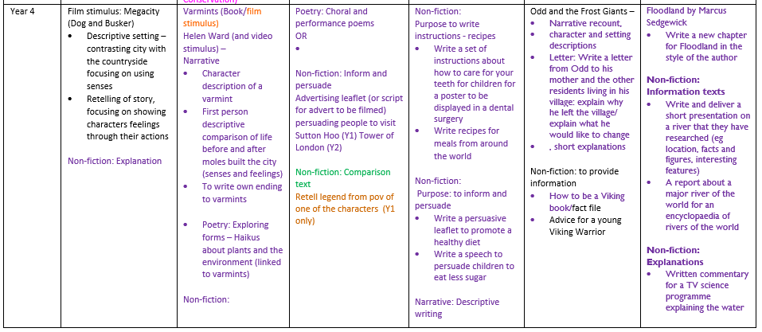
Year English Curriculum

Slide 7
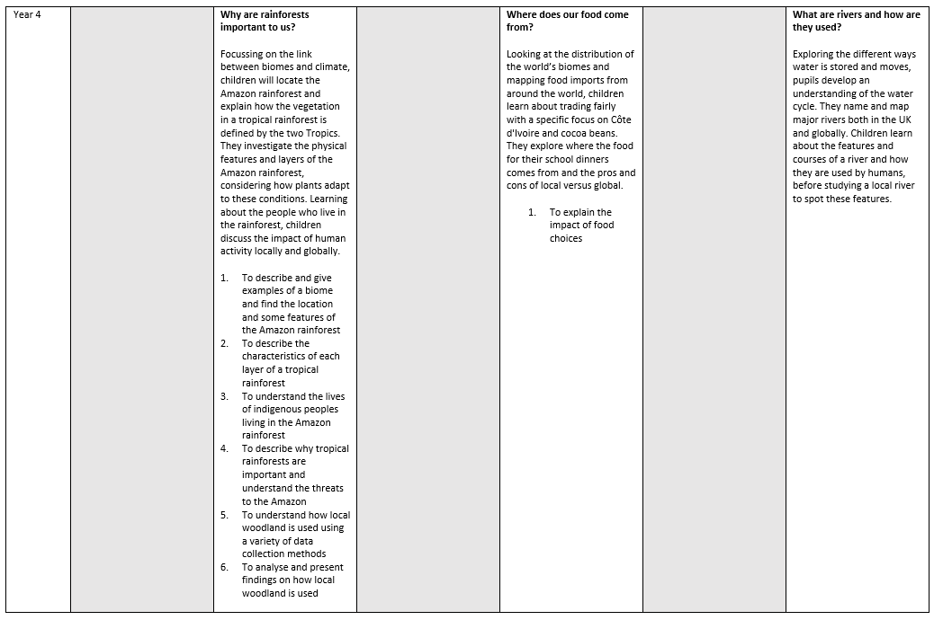
Geography Curriculum

Slide 8
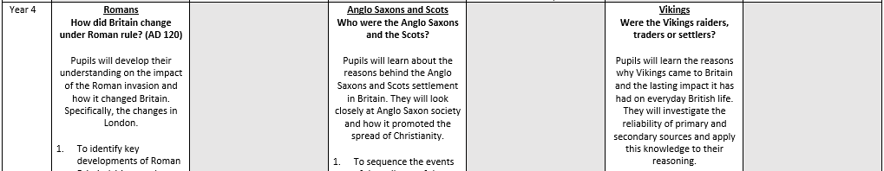
History Curriculum

Slide 9
Key Objectives

Slide 10
Physical Education
PE lessons
Monday (Cricket), Tuesday and Thursday
PE kit:

Slide 11

A School That Loves Reading
Expectations
Home-School Reading
Class Library
School Library

Slide 12
Homework
Reading: minimum of 20 minutes a day
Spelling/English and maths homework will be given out on Friday, to be returned the following Wednesday. Some homework will feed directly into the children’s class work, so all homework must be completed on time.
A Home Learning Project will be set at least once a term,.This will be a longer piece of work involving research on an area associated with the class topic, or with a whole school focus. Children will be given four weeks to plan and complete their project.

Slide 13
Communication
Day-to-day
Parentmail
School newsletter (fortnightly)
Website
Half termly class newsletter
Parents’ Meetings

Slide 14
Support
Phase Leader:
Inclusion/SEND: Catrin Cunnington

Slide 15
Parental Involvement

Slide 16
Trips
Volunteers
Voluntary Payments
Coming up this term –

Slide 17
Equipment
Medical
Book Bag
School uniform
PE Kit
Lunch box
Coat for wet weather

Slide 18
Other
Interventions
Pick up and drop off
Birthday celebrations – donate a book to the class (no sweets or cakes)

Slide 19
Concerns
Complaints procedure (see Complaints Policy on our website)

Slide 20
Questions

