Slide 1

St. Augustine’s CE Primary
Meet the Teacher Meeting
Year Reception
September 2025

Slide 2
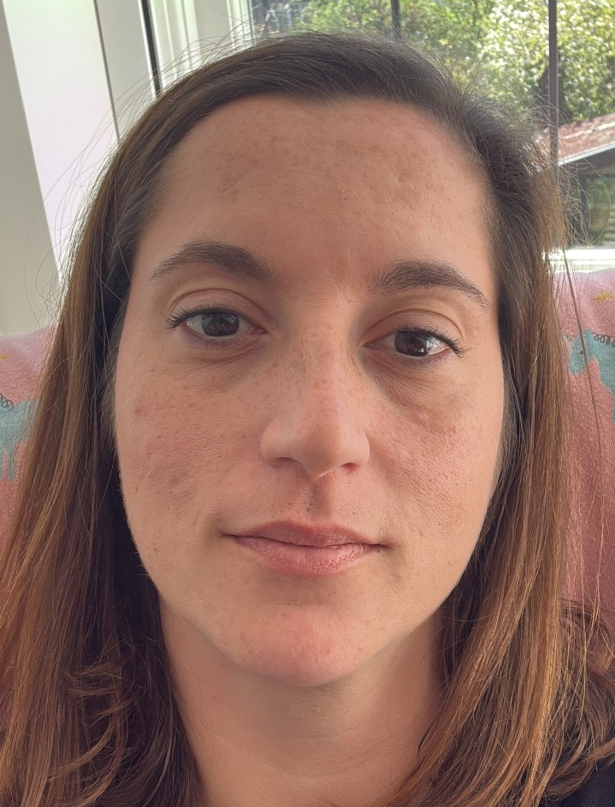
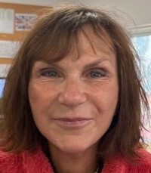
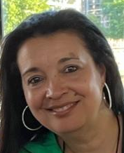
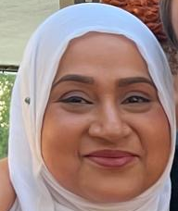
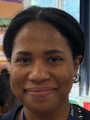
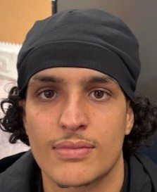
The teaching team
Class teacher: Mrs Sorbello-Bali
I am the main class teacher. I am in class with the children all day Monday and Tuesday, and until 1pm on Wednesday, Thursday and Friday.
Additional teacher: Ms Sophie Rouffiac
Ms Sophie will be with the children every afternoon from 1pm, except Wednesday.
Additional practitioners: Sharon George
Miss George is the Nursery practitioner; she is in class with the Reception children on a Wednesday afternoon from 1pm.
Classroom support: Mrs Uddin
Mrs Uddin is in class with the children at all times.
Additional classroom support: Miss Oasis, Mr Yusuf and
Mr Anis
Miss Oasis, Mr Yusuf and Mr Anis help support the whole class, as well as supporting certain children with special needs.

Slide 3
The school day
8.45 | Reception children soft start
9.00 | Start of school day for Reception
11.30 | Reception lunch time
3.30 | Reception pick up time

Slide 4
What our day looks like
In Early Years all learning is cross-curricular so all areas of the curriculum are interlinked
8.45 – 9.30 Soft start / child initiated activities
9.30-9.50 – Maths Meeting Board – day of the week, date, month and year / weather. Review numbers to 10 and mathematical concepts we have been learning.
Maths –we use a program of study called White Rose, designed by mathematicians and teachers to ensure children have a sound knowledge of mathematical concepts and skills. This program of study is used all the way up to Year 6.
9.50 –11.00 - Free flow/adult initiated activities – activities are set up in the classroom for children to choose. The activities relate to the learning objectives for the week, although children are also encouraged to initiate their own learning by selecting their own resources. An adult will also work with small groups of children on a focus activity for the week.
11.00 – Phonics - learning the names and sounds of the letters of the alphabet (how to read and write the letters). We teach children how to blend these sounds to read words and simple sentences.
11.30 - Lunchtime
12.30 – 12.50 – Depending on the day of the week, there will be a whole class lesson covering either Literacy, Religious Education, Understanding of the World, Expressive Arts and Design or Physical, Social and Emotional Development
12.50 – 14.40 – Free flow/adult initiated activities (as in the morning)
14.40-15.00 -Tidy up time – it is important that children understand that they have a responsibility to keep their classroom and outdoor area tidy – this links to one of our rules.
15.00 – 15.30 - Story & Singing time
THE TIMETABLE WILL CHANGE THROUGHOUT THE YEAR – AS THE CHILDREN’S LISTENING, ATTENTION AND ACADEMIC SKILLS IMPROVE, THE CARPET TIMES WILL INCREASE AND THERE WILL BE MORE FOCUSSED WORK.

Slide 5
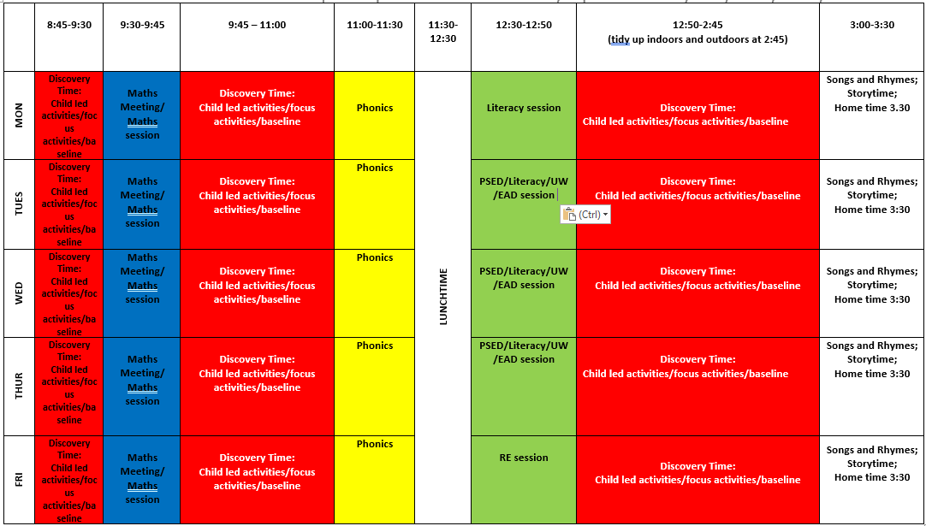
Daily timetable

Slide 6
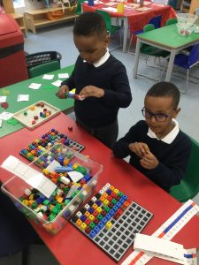
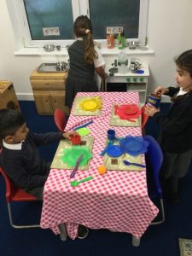
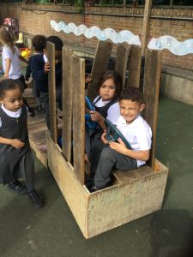
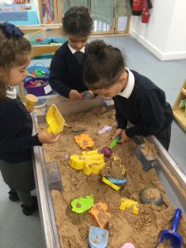
School Values
Friendship
Respect
Wisdom
Inclusion
Honesty
Courage
“To be the best that
we can be in faith, hope
and love so that we
may live life in all its fullness.”

Slide 8
Expectations
Attendance
Punctuality
Rules and Responsibilities
Behaviour, rewards and sanctions
Healthy school – nut avoidant

Slide 9
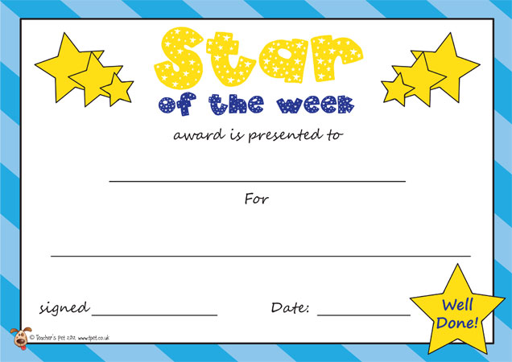
Behaviour Expectations
Class Dojos
Children are awarded Class Dojos in class for showing our school values
Wonderful Work and Shining Stars
A certificate is given out weekly by the Headteacher to celebrate an individual's contribution
Homework Stars
Every week at least two children will be chosen
as homework stars and will get to choose a prize from our class prize box

Slide 10

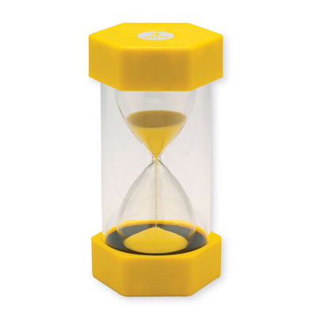

Behaviour Expectations
Traffic Light System
A class traffic light system is in place in classrooms for when children are not following the rules. All children start on green at the beginning of each day
Moving to red will result in a 5-minute think time in class
If the child continues to not follow the rules then it will result in a 15-minute think time, which parents will be informed of
If a child receives three 15-minute think sheets over a two week period a meeting will be arranged between the parent and the class teacher

Slide 11
Year R Curriculum
Aut 1: All About Me
Aut 2: Light and Dark
Spr 1: Traditional Tales
Spr 2: Plants and Growth
Sum 1: At the Zoo
Sum 2: Journeys and Transport

Slide 12
4 key principles
A unique child- Every child is a unique child, who is constantly learning and can be resilient, capable, confident and self assured.
2. Positive relationships- Children learn to be strong and independent through positive relationships.
3. Enabling environments - Children learn well in enabling environments, in which their experiences respond to their individual needs and there is a strong partnership between practitioners and parents/carers.
Learning and development - Children learn and develop in different ways and at different rates. The framework covers the education and care of all children in early years settings, including children with special educational needs and disabilities.
Within this theme are seven areas of learning and these must shape the educational programme in early years settings. All areas are interconnected but there are three areas that are particularly crucial for igniting children’s curiosity and enthusiasm for learning, for building children’s capacity for learning and to help them form relationships and thrive.

Slide 13
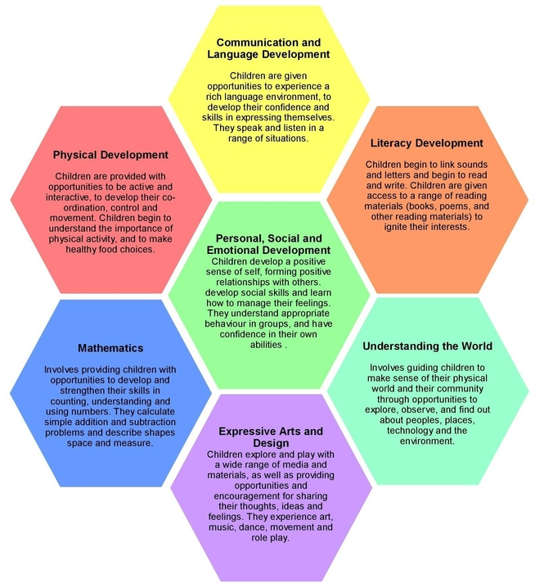
The Early Years Foundation Stage Curriculum
https://www.gov.uk/government/publications/early-years-foundation-stage-framework--2

Slide 14


School uniform
White polo shirt
Navy blue V neck jumper or cardigan
Grey or black trousers, grey skirt or pinafore dress
White socks, grey or navy tighst for girls, grey socks for boys
All black shoes/trainers (no logos)
School bookbag or backpack
PLEASE LABEL ALL ITEMS OF CLOTHING
The only jewellery that children are allowed to wear to school are stud earrings if they have pierced ears. Necklaces and bracelets are not allowed.

Slide 15
Physical Education
PE lessons will start on the week beginning 10th October and will be on Tuesday afternoons. The children should keep their PE kit at school so that they can change into it after lunch on Tuesday – this helps the children develop their self-care skills.
PE kit:
Navy blue tracksuit bottoms (no stripes) or shorts (for summer term)
White polo shirt
Navy blue round neck jumper
White or grey socks
All black trainers

Slide 16
Phonics, reading and writing
At St. Augustine’s we use the ‘Letters and Sounds – Little Wandle’ scheme of work to teach the children how to read and write.
Initially, children will be taught how to write each letter separately, but further up the school, once they become more confident they will be taught to join these letters together when writing words and sentences (this is called cursive handwriting)
A B C D E F G H I J K L M N O P Q R S T U V W X Y Z
a b c d e f g h i j k l m n o p q r s t u v w x y z

Slide 17
Home-School Reading & Homework
Parents are expected to spend at least 10 minutes EVERY DAY reading with their child and write a comment in their reading record, using one box for each day.
Book bags need to come to school every day with your child’s reading record and school story/reading books.
Children will only change their books once a week (every Friday)
After the half term, children will have homework every week on Friday. Homework will need to be brought back into school on the following Wednesday.
Home Learning Projects: at times there will be a longer piece of work involving research on an area associated with topic.

Slide 18
Equipment
Medical equipment (if required, tell teacher)
Book Bag
PE Kit (to be kept at school – please label all items of clothing)
Lunch boxes (healthy and nut free if your child is packed lunch)
A filled water bottle
Coat for wet play days (we suggest children bring a coat every day regardless)
Wellington Boots

Slide 19
Communication
Parent emails
Website
https://www.staprimary.org/
Half termly class newsletter
Fortnightly headteacher newsletter
Parent Teacher meetings (TBC)

Slide 20
Concerns and Meetings
If you would like to discuss something with your teacher, please arrange an appointment with them or contact the office to make an appointment
If you have any concerns, please first go to the class teacher
If these concerns have not been addressed, please then request a meeting with a member of the Senior Leadership Team

Slide 21
Support
EYFS Phase Leader, Phonics and Safeguarding Lead: Mrs Sorbello-Bali
Inclusion/SEND: Ms Toussaint
Curriculum: Ms Voyle
First Aid/Medical Needs: Miss George

Slide 22
Trips
Every term the children will be going on a class trip to Forest School (based in Paddington Recreation Ground). Our first Forest School trip will take place on Thursday 17th October (letter to follow in the upcoming days).
More information will be given closer to the time about further class trips

Slide 23

Accidents
Please tell us about any accidents your child has had outside of school, especially if they have left a mark. We will inform you at the end of the day if your child has had an accident and injured themselves. If the injury is on the head, the office will phone you to inform you of what has happened.

